Slide 1
TourismSG
INF2003
Members: Ryan Ang Rui Heng, Daryl Wong Le Jie, Kinston Lim Kun Wei, Chua Jia Jun Jeston, Teng Xin Yi, Lim Jie Yi Valerie
Kinston (2400746)

Slide 2
Background & Project Motivation
01
02
03
04
Planning
Unified Platform
Travel planning can be complicated, users need to visit multiple websites for information
Tourism platform that simplifies the entire process
Data & Content Needs
Hybrid Architecture
Modern tourism platforms requires both transactional consistency (bookings/user accounts), and flexible real time content (reviews)
Needs a platform built on hybrid architecture that uses SQL for reliable, structured data, and NoSQL for flexibility, like user generated content
Kinston (2400746)

Slide 3

System Description
Main Application
Browse attractions, hotels, food places, concerts
View details + images
Book hotels and concerts
Leave reviews (NoSQL)
Itineraries (NoSQL)
AI chatbot integration (SQL & NoSQL)
Secure user authentication
Datasets usage
Data.gov.sg — Attractions, hotels, food places
Kaggle — Concerts, event datasets
Tourism APIs — Additional details
Kinston (2400746)

Slide 4
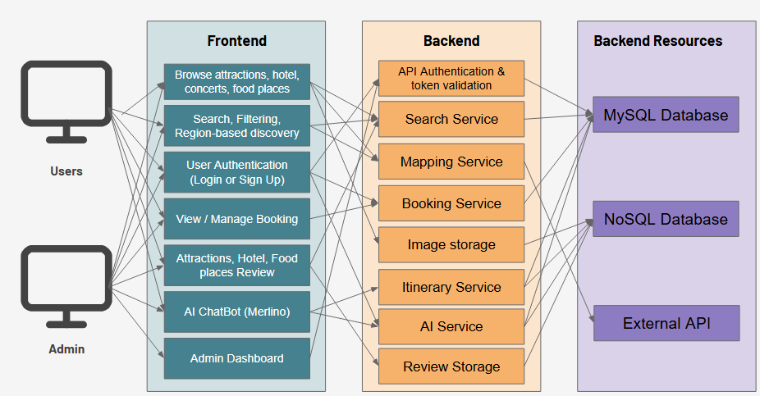
System Architecture
Jeston [2402030]

Slide 5
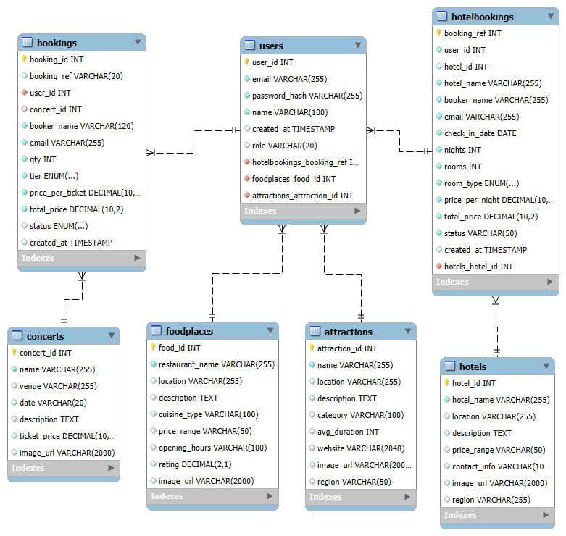
ER Diagram
Jeston [2402030]

Slide 6
Relational Database
Normalized Schema (3NF): Ensure that all non-key attributes depends solely on the primary key
Complex Query Operations: Advanced Joins
Robust Constraints:
SELECT b.booking_id, u.name, c.name AS concert_name, b.qty FROM bookings b JOIN users u ON b.user_id = u.user_id JOIN concerts c ON b.concert_id = c.concert_id;
UNIQUE(emails) to prevent duplicate
NOT NULL on critical fields
Foreign keys with CASCADE rules to maintain booking integrity
Index Optimization
Secure Prepared Statements
Composite indexes on (region, hotel_name)
Category-based index for attractions
Improved query performance for heavy search & filtering
All queries use prepared statements
Prevents SQL injection
Ensures safer user authentication and booking creation
Jeston [2402030]

Slide 7
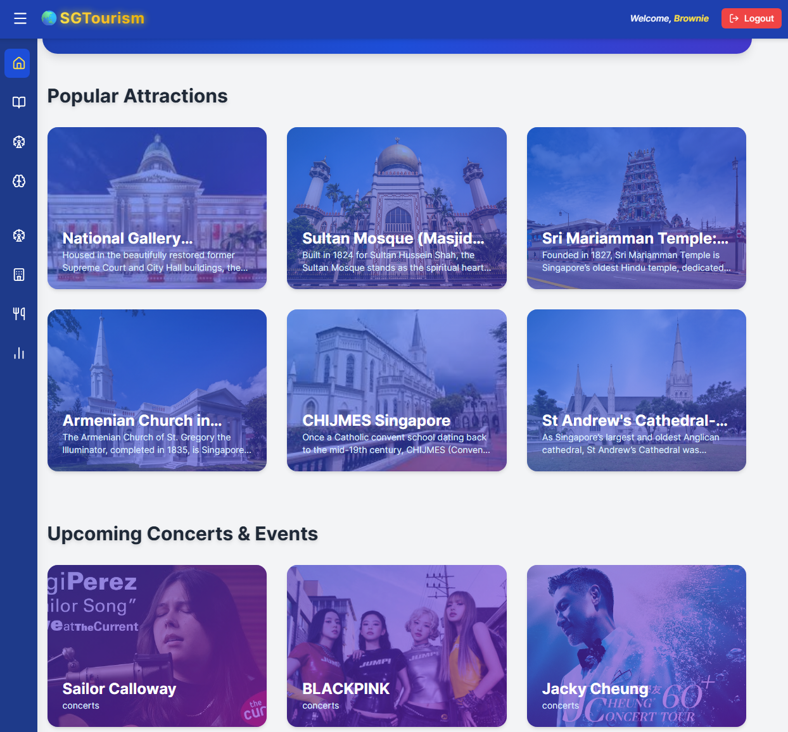
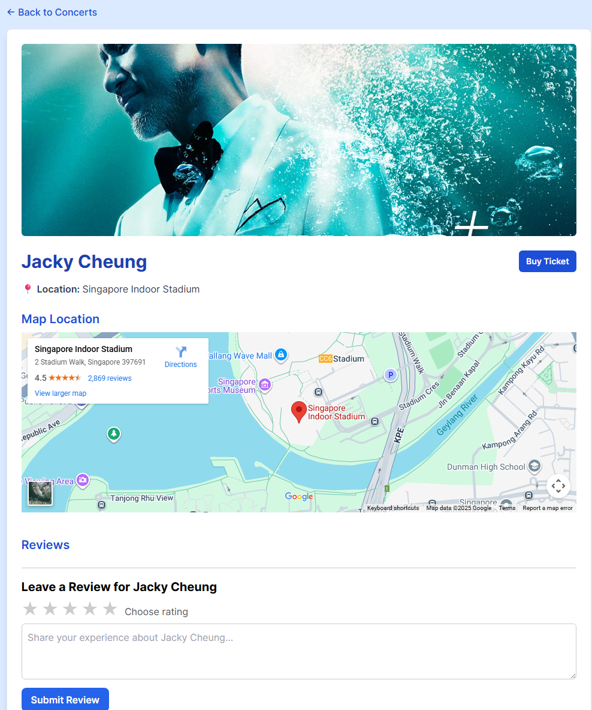
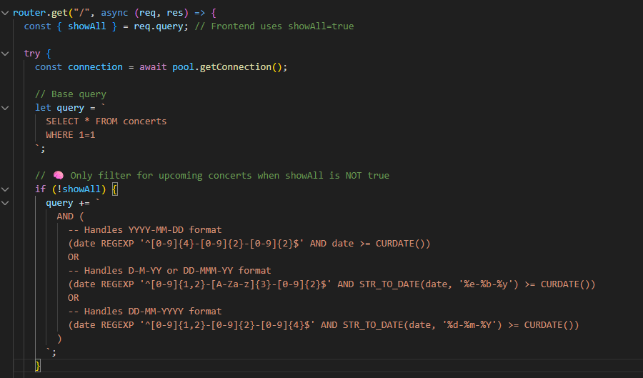
SQL Demo in our webpage
Asher

Slide 8
Advanced SQL Features
Parsing mixed date formats using STR_TO_DATE
What makes our SQL Implementation strong?
Prepared statements (SQL injection prevention)
Parsing mixed date formats using STR_TO_DATE
JOIN queries to combine user + concert data
Secure booking reference generation (HB-XXXXXX, CB-XXXXXX)
SQL
Dynamic filters for region, file cleaning
Efficient Index Optimization for Faster Queries
Asher

Slide 9
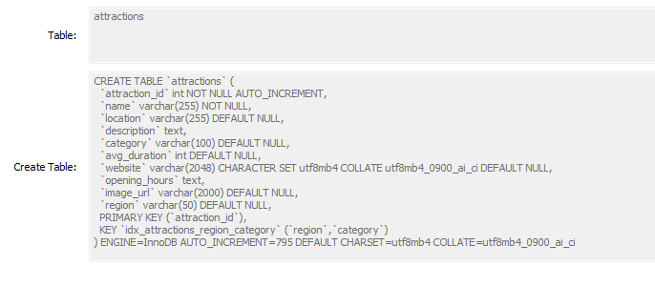
Advanced SQL
Indexing
Table-Level Constraints
Composite Indexing for Performance
Table-Level Constraints
Structured Schema with 3NF Normalization
Valerie Lim (2403089)

Slide 10
NoSQL
Collections implementation
Application Of Firestore
Document Structure
Each record stored as a JSON-like document
Flexible fields (e.g., food places may have cuisine, attractions may have tags)
Automatically indexed for fast read operations
The React frontend interacts directly with Firestore via the Firebase SDK
Detail pages pull Firestore documents to display content instantly
Reviews update the UI in real-time using Firestore listeners
Admin can push updates (new foodplace / attraction entries) without modifying SQL schema
Attractions/Concerts/Hotels/Food Places
Chatlog
Review
Valerie Lim (2403089)

Slide 11
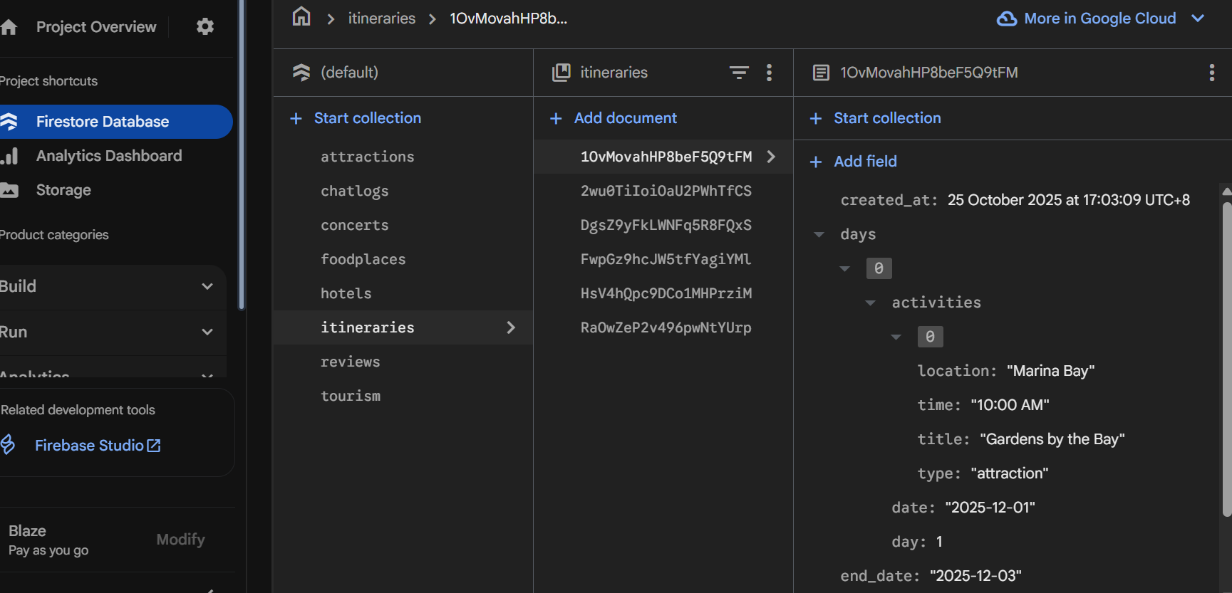
NoSQL DEMO
Firestore:
Stores documents with a flexible schema structure​
Each itinerary document has a timestamp of when it is created and days array
In the days array there is an activities array with different attributes​
Not all the itineraries need the same fields, showing a dynamic model
Nested NoSQL documents
Such things would be difficult to store in SQL without using multiple JOIN tables
Daryl Wong (2401117)

Slide 12
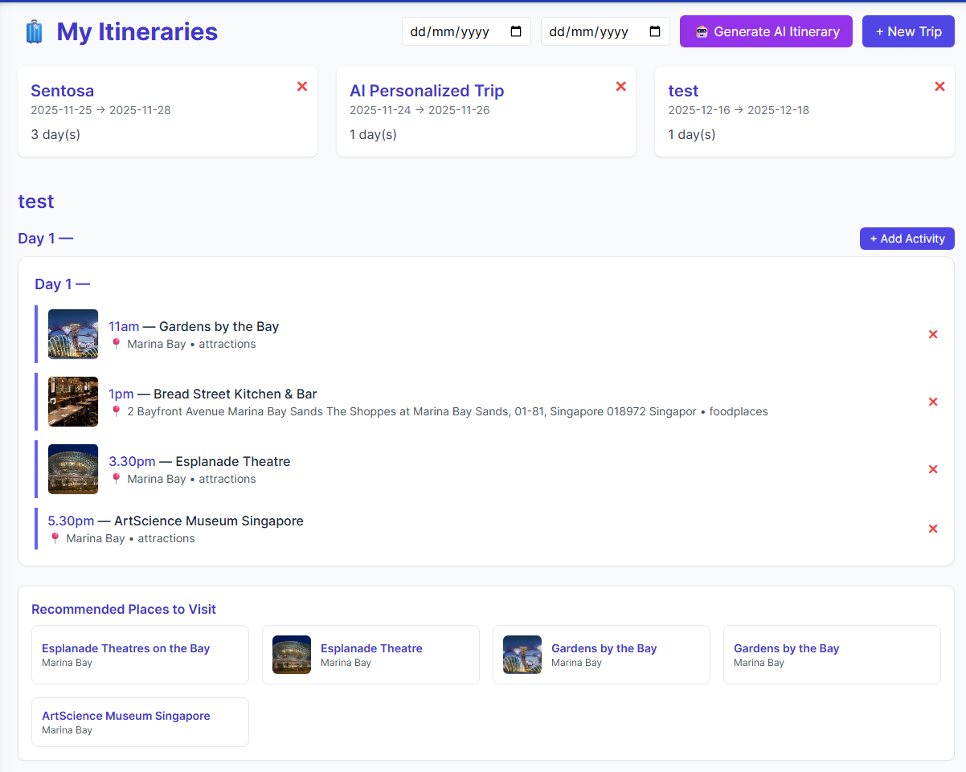
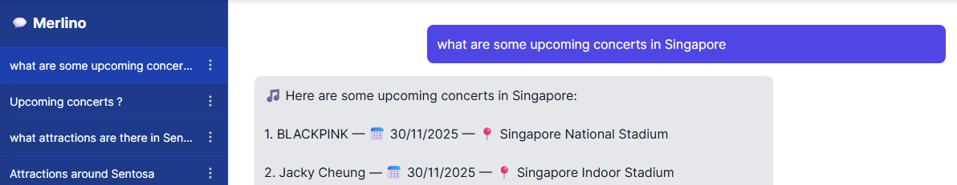
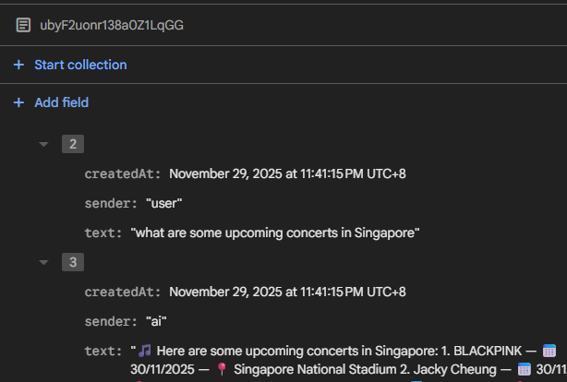
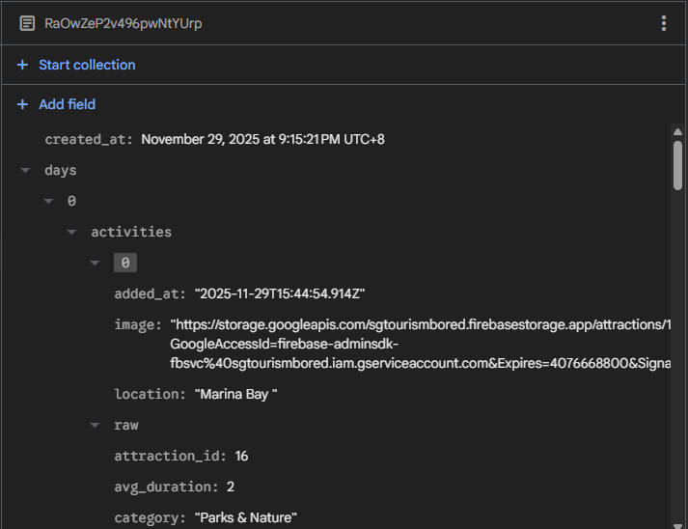
AI & Itinerary Demo
Daryl Wong (2401117)

Slide 13
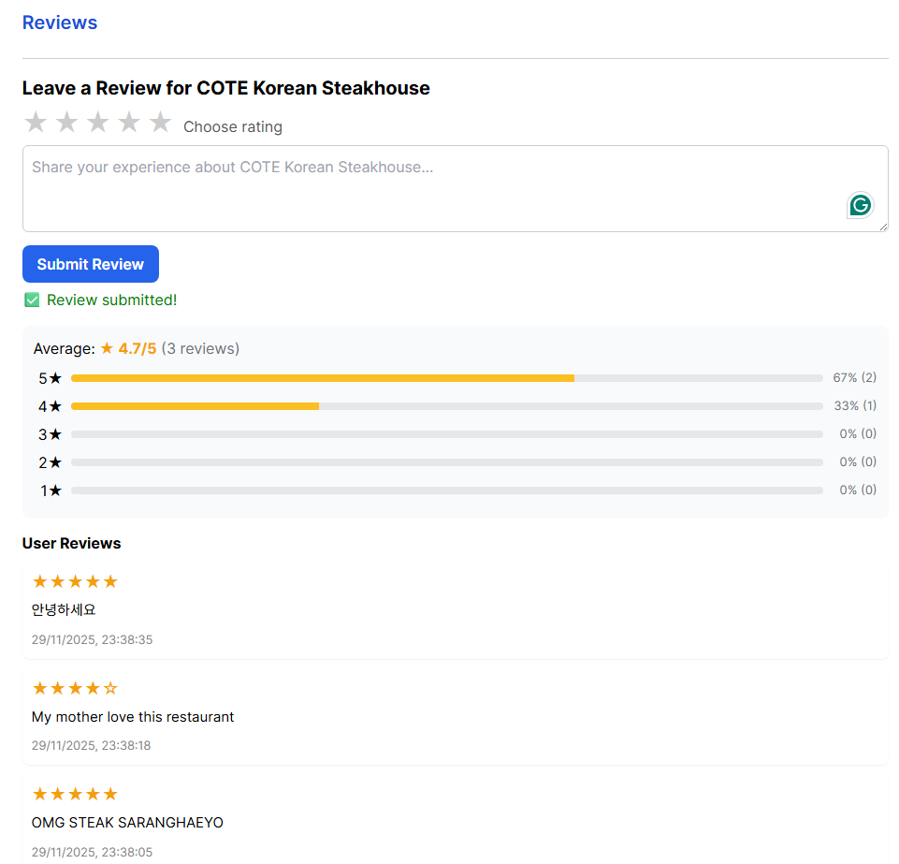
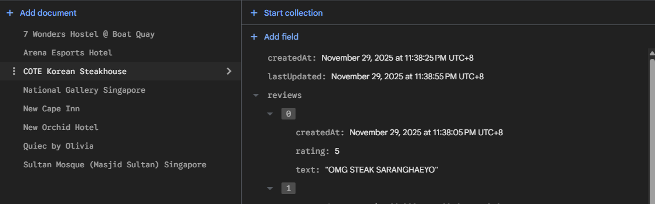
Review Demo
Ryan Ang
2400522

Slide 14
SQL vs NoSQL Comparison
SQL | NoSQL
Structured, relational tables in 3NF | Schema-less documents with flexible fields.
Foreign keys, UNIQUE(email), NOT NULL — strong consistency + referential integrity | No enforced constraints; consistency handled at application level
Supports JOINs, aggregates, complex filters, composite indexes | Simple filtered queries; no JOINs; relies on composite indexes for speed
25–60 ms reads, 30–50 ms writes; JOIN queries slightly heavier | Fast small writes (8–15 ms) and cached reads (~5–10 ms)
Transactional & structured data: bookings, listings, authentication | High-frequency, user-generated content: reviews, logs, image metadata.
Schema changes require migrations; scaling requires stronger hardware | Evolves without migrations; horizontal auto-scaling built-in
Ryan Ang
2400522

